Slide 1
Wireless Concepts V2.2

Slide 2
To be Covered
Overview
Wireless Standards
Wireless Access Points
CSMA/CA
Wireless Router
Configurable Parameters on Wireless Router
802.11 WLAN Technologies
Planning the Wireless LAN

Slide 3
Wireless LANs
Most current business networks rely on switch-based LANs for day-to-day operation inside the office.
However, workers are more mobile today and want to maintain access to their business LAN resources from locations other than their desks.
Workers in the office want to take their laptops to meetings or to a co-worker's office.
You can see portability and mobility in everything from cordless keyboards and headsets, to satellite phones and global positioning systems (GPS).
The WLAN is essentially an extension of the Ethernet LAN.
Notes:
3
Use graphic 1.1.1.1
Use graphic 1.1.1.3

Slide 4
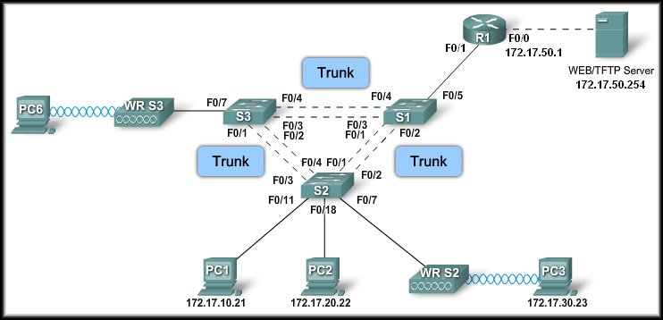
Wireless LANs - An Extension of Ethernet LANs
Notes:
4
Use graphic 1.1.1.1
Use graphic 1.1.1.3

Slide 5
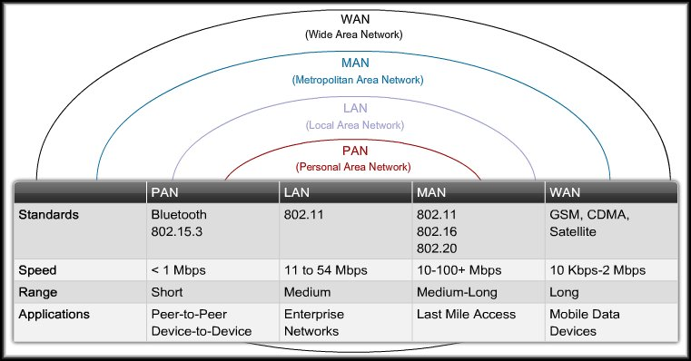
Wireless Technologies
Notes:
5
Use graphic 1.1.1.1
Use graphic 1.1.1.3

Slide 6
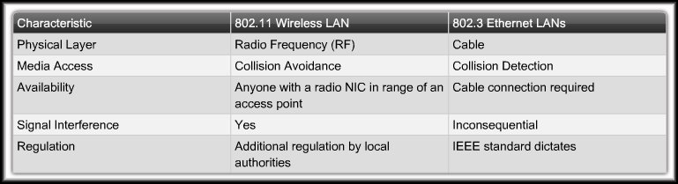
Comparing a WLAN to a LAN
No Collisions
Notes:
6
Use graphic 1.1.1.1
Use graphic 1.1.1.3

Slide 7
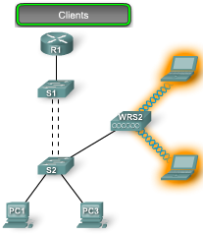
Wireless LANs
802.11 wireless LANs extend the wired 802.3 Ethernet LAN infrastructures
In a WLAN, each client uses a wireless adapter to gain access to the network through a wireless device - router or access point.
Wireless adapter in the client communicates using RF signals.
Once connected to the network, wireless clients can access network resources just as if they were wired to the network.
Wireless
Wired Infrastructure
RF Signal
Notes:
7
Use graphic 1.1.1.1
Use graphic 1.1.1.3

Slide 8
Wireless IEEE 802.11 LAN Standards
The standards define how radio frequency (RF) in the unlicensed industrial, scientific, and medical (ISM) frequency bands is used for the physical layer and the MAC sub-layer of wireless links.
Data Rate:
802.11: 1 - 2 Mbps
802.11a and g: support up to 54 Mbps,
802.11b: supports up to a maximum of 11 Mbps,
802.11n: up to 150 Mbps.
802.11ac: up to 800 Mbps
Modulation technique:
Direct Sequence Spread Spectrum (DSSS)
Simpler of the two methods.
Less expensive to implement.
802.11b and 802.11g.
Orthogonal Frequency Division Multiplexing (OFDM).
Faster data rates than DSSS.
802.11a, 802.11g (2003), 802.11n (2009), 802.11ac (2013)
Notes:
8
Use graphic 1.1.1.1
Use graphic 1.1.1.3

Slide 9
Wireless IEEE 802.11 LAN Standards
Band:
2.4 GHz:
802.11b, 802.11g, 802.11n
5 GHz:
802.11a, 802.11n, 802.11ac
Non Overlapping Channels:
802.11n 3
802.11ac 25
Notes:
9
Use graphic 1.1.1.1
Use graphic 1.1.1.3

Slide 10
Wi-Fi Certification
The 3 key organizations influencing WLAN
standards:
ITU-R
Regulates allocation of RF bands.
IEEE
Specifies how RF is modulated to carry information.
The IEEE developed and maintains the standards for LAN and MAN. The dominant standards in the IEEE 802 are 802.3 Ethernet, and 802.11 Wireless LAN.
Wi-Fi Alliance (www.wi-fi.org)
Ensures that vendors make devices that are interoperable.
Aim to improve the interoperability of products by certifying vendors for conformance to industry norms and adherence to standards.
Notes:
10
Use graphic 1.1.1.1
Use graphic 1.1.1.3

Slide 11
Wireless Access Point (AP)
Connects wireless clients to the wired LAN.
Client devices do not typically communicate directly with each other, they communicate with the AP.
The AP converts the TCP/IP data packets from the:
802.11 frame encapsulation format in the air
to the
802.3 frame encapsulation format on the wired Ethernet
Notes:
11
Use graphic 1.1.1.1
Use graphic 1.1.1.3

Slide 12
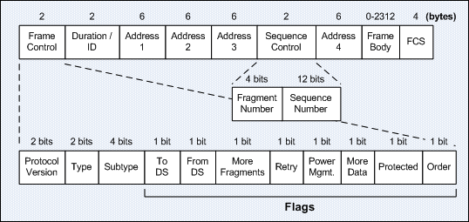
802.11 frame – 4 Address Fields

Slide 13
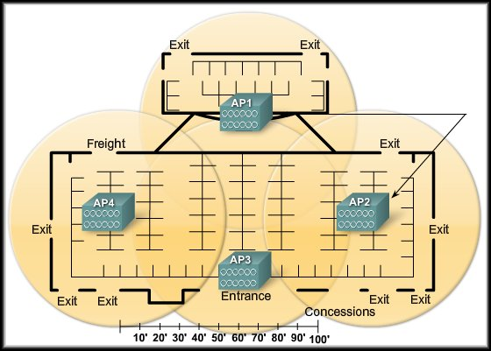
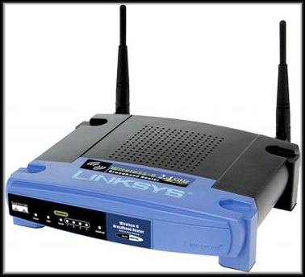
Wireless Access Points
Notes:
13
Use graphic 1.1.1.1
Use graphic 1.1.1.3

Slide 14
CSMA/CA
Access points oversee a distributed coordination function (DCF) called Carrier Sense Multiple Access with Collision Avoidance (CSMA/CA).
This simply means that devices on a WLAN must sense the medium for energy (RF stimulation above a certain threshold) and wait until the medium is free before sending.
If an AP receives data from a client station, it sends an ACK to the client that the data has been received.
This ACK stops the client from assuming that a collision occurred and prevents a data retransmission by the client.
Notes:
14
Use graphic 1.1.1.1
Use graphic 1.1.1.3

Slide 15
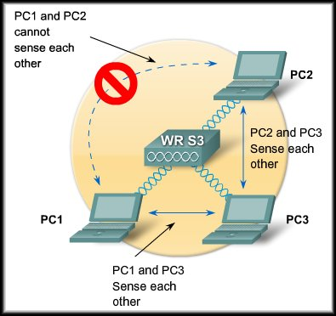
CSMA/CA – Hidden Node Problem
The Hidden Node Problem:
PC1, PC2 and PC3 sense WRS3
PC1 and PC2 cannot sense each other
PC1
does not detect PC2 activity on the channel
sends data while PC2 is transmitting
A collision occurs
PC3 is sensed by both PC1 and PC2, so there are no collisions involving PC3
Notes:
15
Use graphic 1.1.1.1
Use graphic 1.1.1.3

Slide 16
CSMA/CA – Hidden Node Resolution
The means of resolving the hidden node problem is a CSMA/CA feature called request to send/clear to send (RTS/CTS).
RTS/CTS was developed to allow a negotiation between a client and an access point.
When RTS/CTS is enabled in a network, access points allocate the medium via CTS to the requesting station for as long as is required to complete the transmission.
When the transmission is complete, other stations can request the channel via RTS. Otherwise, the normal collision avoidance function is resumed.
Notes:
16
Use graphic 1.1.1.1
Use graphic 1.1.1.3

Slide 17
Wireless Router – Linksys WRT310N
Performs the role of AP, Ethernet switch, and router.
Is really three devices in one box:
A wireless AP, which performs the typical functions of an AP.
A built-in four-port, full-duplex, 10/100/1000 switch provides connectivity to wired devices.
The router function provides a gateway for connecting to other network infrastructures.
It is most commonly used as a small business or residential wireless access device.
The expected load on the device is low enough that it should be able to manage the provision of WLAN, 802.3 Ethernet, and connect to an ISP.
Notes:
17
Use graphic 1.1.1.1
Use graphic 1.1.1.3

Slide 18
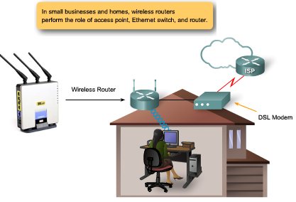
Wireless Router – Linksys WRT310N
Notes:
18
Use graphic 1.1.1.1
Use graphic 1.1.1.3

Slide 19
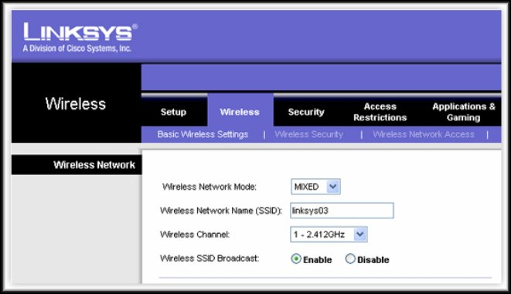
Configurable Parameters for Wireless Endpoints
Notes:
19
Use graphic 1.1.1.1
Use graphic 1.1.1.3

Slide 20
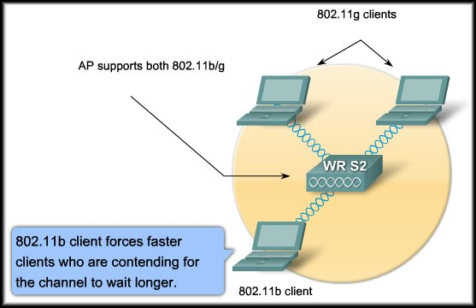
Configurable Parameters for Wireless Endpoints
Wireless Network Mode:
Refers to the WLAN protocols: 802.11a, b, g, or n.
When a Linksys AP is configured to allow both 802.11b and 802.11g clients, it is operating in mixed mode.
For an AP to support 802.11a as well as 802.11b and g, it must have a second radio to operate in the different RF band.
Notes:
20
Use graphic 1.1.1.1
Use graphic 1.1.1.3

Slide 21
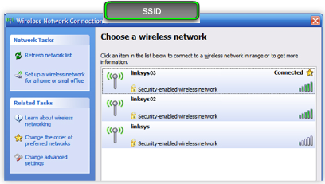
Configurable Parameters for Wireless Endpoints
Service Set Identifier (SSID):
Is a unique identifier that client devices use to distinguish between wireless networks.
Several access points on a network can share an SSID.
SSID can be any alphanumeric, case-sensitive entry from 2 to 32 characters long.
All Linksys AP's are set to the network name of linksys, Cisco AP's are initially set to tsunami.
Notes:
21
Use graphic 1.1.1.1
Use graphic 1.1.1.3

Slide 22
Configuring the Wireless Router – Linksys WRT300N LabC3 7-1_7.5.1 Basic Wireless Configuration P291
Power UP wireless router (get a wireless router from your instructor)
Reset it to factory default – push reset button and hold until blue symbols flashes
Start up PC Ethernet VM, configure to obtain ip address automatically
Ethernet Connection – plug blue UTP cable from your PC into any Ethernet port (1 to 4) on the wireless router
Open DOS Command Window – type ipconfig /all to confirm PC Ethernet has been obtained an ip address from wireless router
Use a Browser to connect to factory default ip address 192.168.1.1 on the wireless router
Authentication – username: admin, password: admin
Wireless Router Setup
Ensure you always click save at the bottom of each screen
Internet Setup
Internet Connection type: static IP
Assign an ip address from VLAN 1 address range
Network Setup - DHCP
For Wireless PCs
Use address space for wireless LAN
Disable/Enable PC Ethernet LAN connection to pick up a new ip address from Wireless LAN address space
Use a Browser to re-connect to new (default gateway) ip address on the wireless router
Security
Disable Firewall
Wireless Wi-Fi Protected Setup
Wireless Configuration: manual
SSID: student Id
Connecting a Wireless PC to the Wireless Router
Logon to another PC
Look for the wireless tray icon – bottom right, click
Associate with the wireless LAN broadcasting your student ID as its SSID
Start up PC Wireless VM and configure to obtain ip address automatically
Open DOS Command Window – type ipconfig /all to confirm an ip address has been obtained from wireless router
From PC Wireless VM Ping default gateway on the wireless router to confirm connection is working
Wireless Router - Remove blue UTP cable from your PC, get a new blue UTP cable, plug into Internet Port
Connect new blue UTP cable to Desk Top coloured enclosure port, then patch from patch panel to MalvernB switch port Fa0/9
From PC Wireless VM Ping to default gateway for VLAN 1 to confirm the connection is working

Slide 23
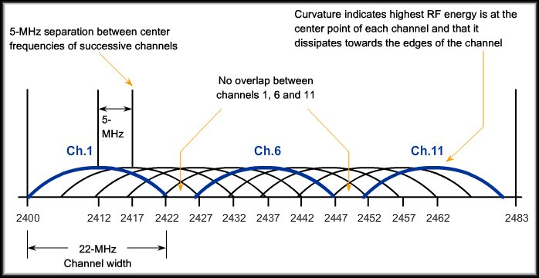
Configurable Parameters for Wireless Endpoints
Wireless Channel:
The 2.4 GHz band is broken down into 11 channels for North America and 13 channels for Europe.
These channels have a center frequency separation of only 5 MHz and an overall channel bandwidth (or frequency occupation) of 22 MHz.
The 22 MHz channel bandwidth combined with the 5 MHz separation between center frequencies means there is an overlap between successive channels.
Best practice for WLANs that require multiple APs is to use non-overlapping channels.
If there are 3 adjacent APs, use channels 1, 6, and 11.
If there are just 2, select any 2 that are 5 channels apart, eg channels 5 and 10.
Notes:
23
Use graphic 1.1.1.1
Use graphic 1.1.1.3

Slide 24
802.11 WLAN Topologies
Ad hoc Network
Wireless networks can operate without AP; this is called an ad hoc topology.
Client stations which are configured to operate in ad hoc mode configure the wireless parameters between themselves.
The IEEE 802.11 standard refers to an ad hoc network as an independent BSS (IBSS).
Basic Service Set (BSS)
AP provides an infrastructure that adds services and improves the range for clients.
A single AP in infrastructure mode manages the wireless parameters and the topology is simply a BSS.
The coverage area for both an IBSS and a BSS is the basic service area (BSA).
Notes:
24
Use graphic 1.1.1.1
Use graphic 1.1.1.3

Slide 25
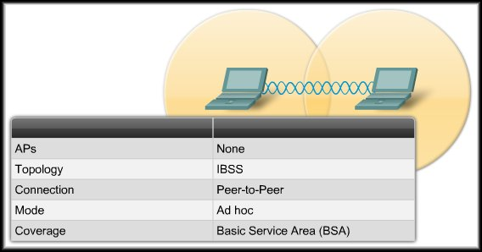
802.11 WLAN Topologies
Ad Hoc (Independent Basic Service Set):
Wireless networks can operate without access points.
Client stations which are configured to operate in ad hoc mode configure the wireless parameters between themselves.
Notes:
25
Use graphic 1.1.1.1
Use graphic 1.1.1.3

Slide 26
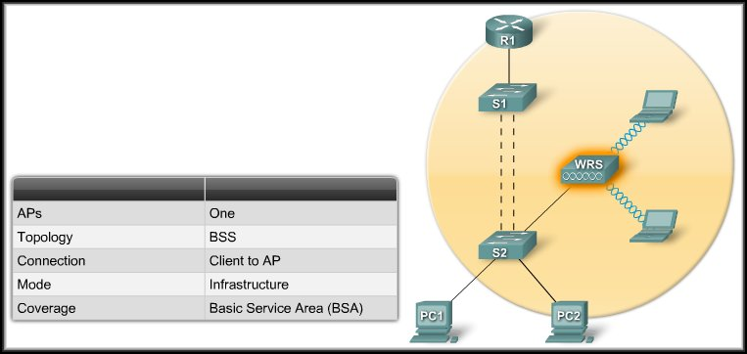
802.11 WLAN Topologies
Basic Service Area
Basic Service Sets (BSS):
Access points provide an infrastructure that adds services and improves the range for clients.
A single access point in infrastructure mode manages the wireless parameters and the topology is simply a BSS.
The coverage area for both an IBSS or a BSS is the basic service area (BSA).

Slide 27
802.11 WLAN Topologies
Extended Service Sets
When a single BSS provides insufficient RF coverage, one or more can be joined through a common distribution system into an extended service set (ESS).
In an ESS, one BSS is differentiated from another by the BSS identifier (BSSID), which is the MAC address of the access point serving the BSS.
The coverage area is the extended service area (ESA).
Common Distribution System
Allows multiple access points in an ESS to appear to be a single BSS.
An ESS generally includes a common SSID to allow a user to roam from AP to AP.
Cells represent the coverage area provided by a single channel.
An ESS should have 10 to 15 % overlap between cells in an extended service area. With a 15 % overlap between cells, an SSID, and non-overlapping channels (one cell on channel 1 and the other on channel 6), roaming capability can be created.
Notes:
27
Use graphic 1.1.1.1
Use graphic 1.1.1.3

Slide 28
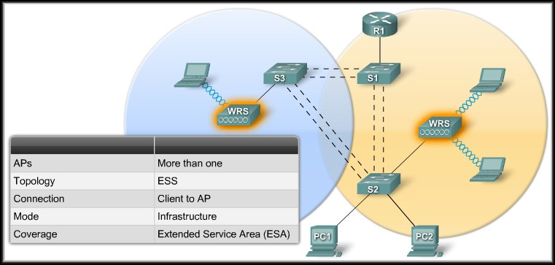
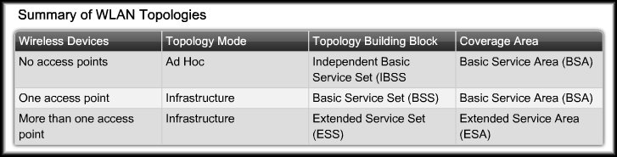
802.11 WLAN Topologies
OverLap 15%
Notes:
28
Use graphic 1.1.1.1
Use graphic 1.1.1.3

Slide 29
802.11 Client and Access Point (AP) Association
A key part of the process is discovering a WLAN and subsequently connecting to it.
The primary components of this process are as follows:
Beacons - Frames used by the WLAN network to advertise its presence.
The primary purpose of the beacon is to allow WLAN clients to learn which networks and APs are available in a given area, thereby allowing them to choose which network and AP to use.
APs may broadcast beacons periodically.
Probes - Frames used by WLAN clients to find their networks.
Authentication - A process which is an artifact from the original 802.11 standard, but still required by the standard.
Association - The process for establishing the data link between an AP and a WLAN client.
Although beacons may regularly be broadcast by an AP, the frames for probing, authentication, and association are used only during the association (or re-association) process.
Notes:
29
Use graphic 1.1.1.1
Use graphic 1.1.1.3

Slide 30
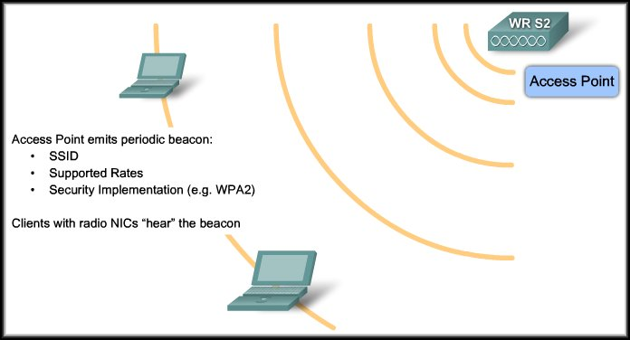
Wireless Association
The only part of the process that may be broadcast on a regular basis. Not necessarily enabled.
Beacons:
Frames used by the WLAN network to advertise its presence.

Slide 31
Wireless Association
Before an 802.11 client can send data over a WLAN network, it goes through the following three-stage process:
Step 1: 802.11 Probing.
Step 2: Authentication.
Step 3: Association.

Slide 32
Wireless Association
Step 1: 802.11 Probing
Clients search for a specific network by:
Sending a probe request out on multiple channels.
Specifies the network name (SSID) and bit rates.
A typical WLAN client is configured with a desired SSID.
Client is simply trying to discover available WLANs:
Sends out a probe request with no SSID.
All access points that are configured to respond to this type of query respond.
WLANs with the broadcast SSID feature disabled do not respond.

Slide 33
Wireless Association
Step 2: Authentication
802.11 was originally developed with two authentication mechanisms.
Open Authentication:
A NULL authentication
The client says "authenticate me”.
The access point responds with "yes”.
This is the mechanism used in almost all 802.11 deployments.

Slide 34
Wireless Association
Step 2: Authentication
Pre-Shared Key Authentication:
Based on a key that is shared between the client station and the access point called the Wired Equivalency Protection (WEP) key.
The idea of the shared WEP key is that it gives a wireless link the equivalent privacy of a wired link, but the original implementation was flawed.
WEP needs to be included in client and access point implementations for standards compliance but it is not used or recommended.
(Security enhancement:
Login authentication: Extensible Authentication Protocol (EAP)
Wireless encryption: WPA and WPA2
Access control: SSID cloaking, MAC address filtering.)

Slide 35
Wireless Association
Step 3: 802.11 Association
Finalizes the security and bit rate options.
Establishes the data link between the WLAN client and the access point.
The client learns the BSSID (MAC Address) of the access point.
Access point maps a logical port known as the association identifier (AID) to the WLAN client.
AID is equivalent to a port on a switch.
Association allows the infrastructure switch to keep track of frames destined for the WLAN client so that they can be forwarded.

Slide 36
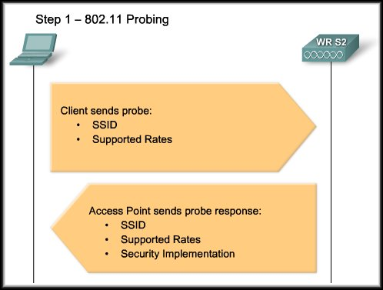
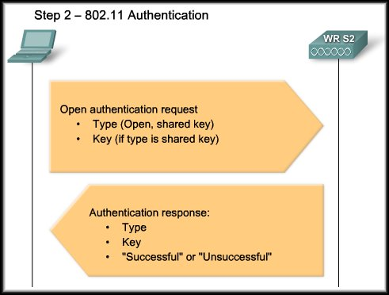
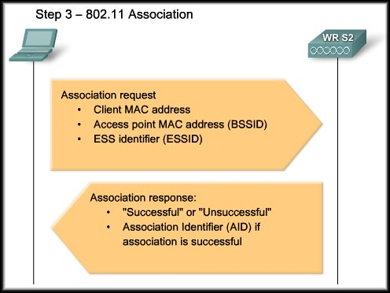
Wireless Association

Slide 37
Planning the Wireless LAN
There needs to be a well-documented plan before a wireless network can be implemented:
The number of users a WLAN can support is not a straightforward calculation.
Depends on the geographical layout of your facility (how many persons and devices fit in a space)
The data rates users expect (because RF is a shared medium and the more users there are the greater the contention for RF),
The use of non-overlapping channels by multiple APs in an ESS, and transmit power settings (which are limited by local regulation).
You will have sufficient wireless support for your clients if you plan your network for proper RF coverage in an ESS.
Notes:
37
Use graphic 1.1.1.1
Use graphic 1.1.1.3

Slide 38
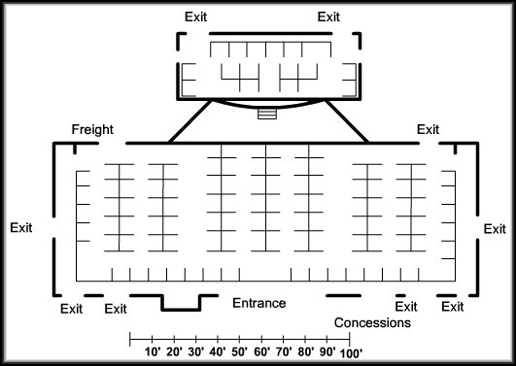
Planning the Wireless LAN
Map:
Notes:
38
Use graphic 1.1.1.1
Use graphic 1.1.1.3

Slide 39
Planning the Wireless LAN
When planning the location of APs, you may not be able to simply draw coverage area circles and drop them over a plan.
If APs are to use existing wiring, position APs
Above obstructions.
Vertically near the ceiling in the center of each coverage area, if possible.
In locations where users are expected to be. Eg, conference rooms are typically a better location for access points than a hallway.
When these points have been addressed, estimate the expected coverage area of an AP. This value varies depending on
the WLAN standard or mix of standards that you are deploying,
the nature of the facility,
the transmit power that the access point
etc
Based on your plan, place APs on the floor plan so that coverage circles are overlapping
Notes:
39
Use graphic 1.1.1.1
Use graphic 1.1.1.3

Slide 40
Planning the Wireless LAN
Example Calculation
The open auditorium (a Warehouse/Manufacturing Building Type) shown in the figure is approximately 20,000 square feet.
Network requirements specify that there must be a minimum of 6 Mb/s 802.11b throughput in each BSA, because there is a wireless voice over WLAN overlaid on this network.
With APs, 6 Mbps can be achieved in open areas like those on the map, with a coverage area of 5,000 square feet in many environments.
Note: The 5,000 square foot coverage area is for a square. The BSA takes its radius diagonally from the center of this square.
Let us determine where to place the access points.
The facility is 20,000 square feet, therefore dividing 20,000 square feet by a coverage area of 5,000 square feet per access point results in at least 4 access points required for the auditorium.
Next, determine the dimension of the coverage areas and arrange them on the floor plan.
Because the coverage area is a square with side "Z", the circle that is tangent to its four corners has a radius of 50 feet, as shown in the calculations.
Notes:
40
Use graphic 1.1.1.1
Use graphic 1.1.1.3

Slide 41
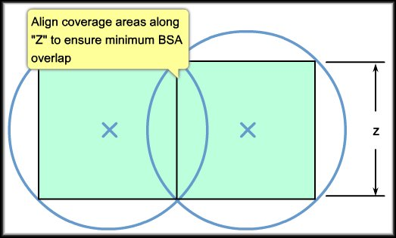
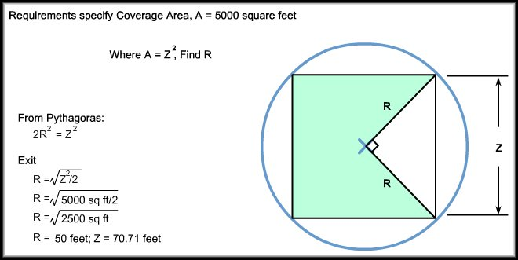
Planning the Wireless LAN
Dimension of Coverage Area
50 foot (15 Meter) Radius
71 foot (22 Meter) Square

Slide 42
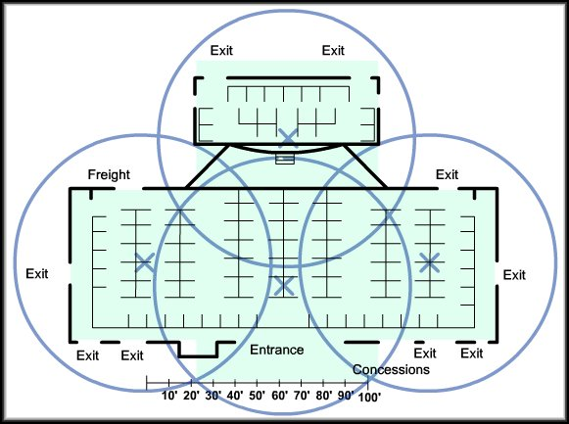
Planning the Wireless LAN
Location of Access Points
Notes:
42
Use graphic 1.1.1.1
Use graphic 1.1.1.3

Slide 43
Covered
Overview
Wireless Standards
Wireless Access Points
CSMA/CA
Wireless Router
Configurable Parameters on Wireless Router
802.11 WLAN Technologies
Planning the Wireless LAN

